Slide 1
Microclimate Research Internship

Slide 2
Overview
Clean the data
Organise the data
Access the data
Analyse the data

Slide 3
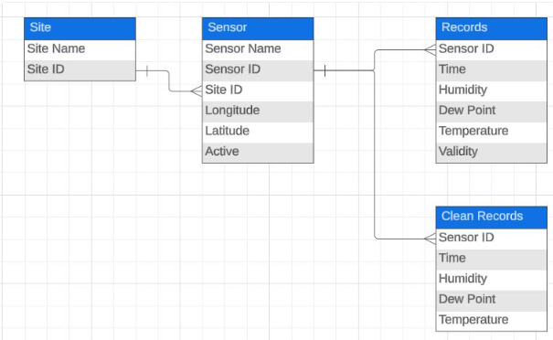
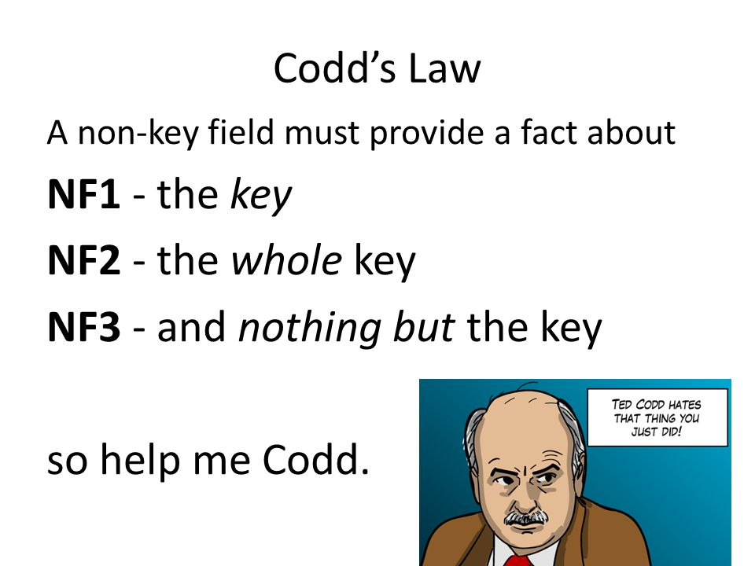
Databases

Slide 4
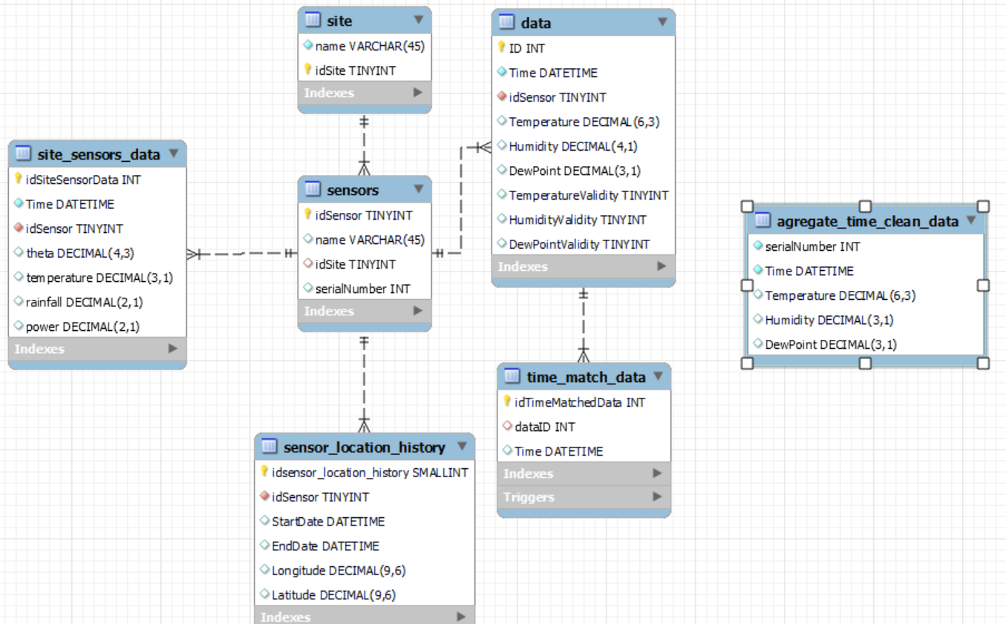
Databases

Slide 5
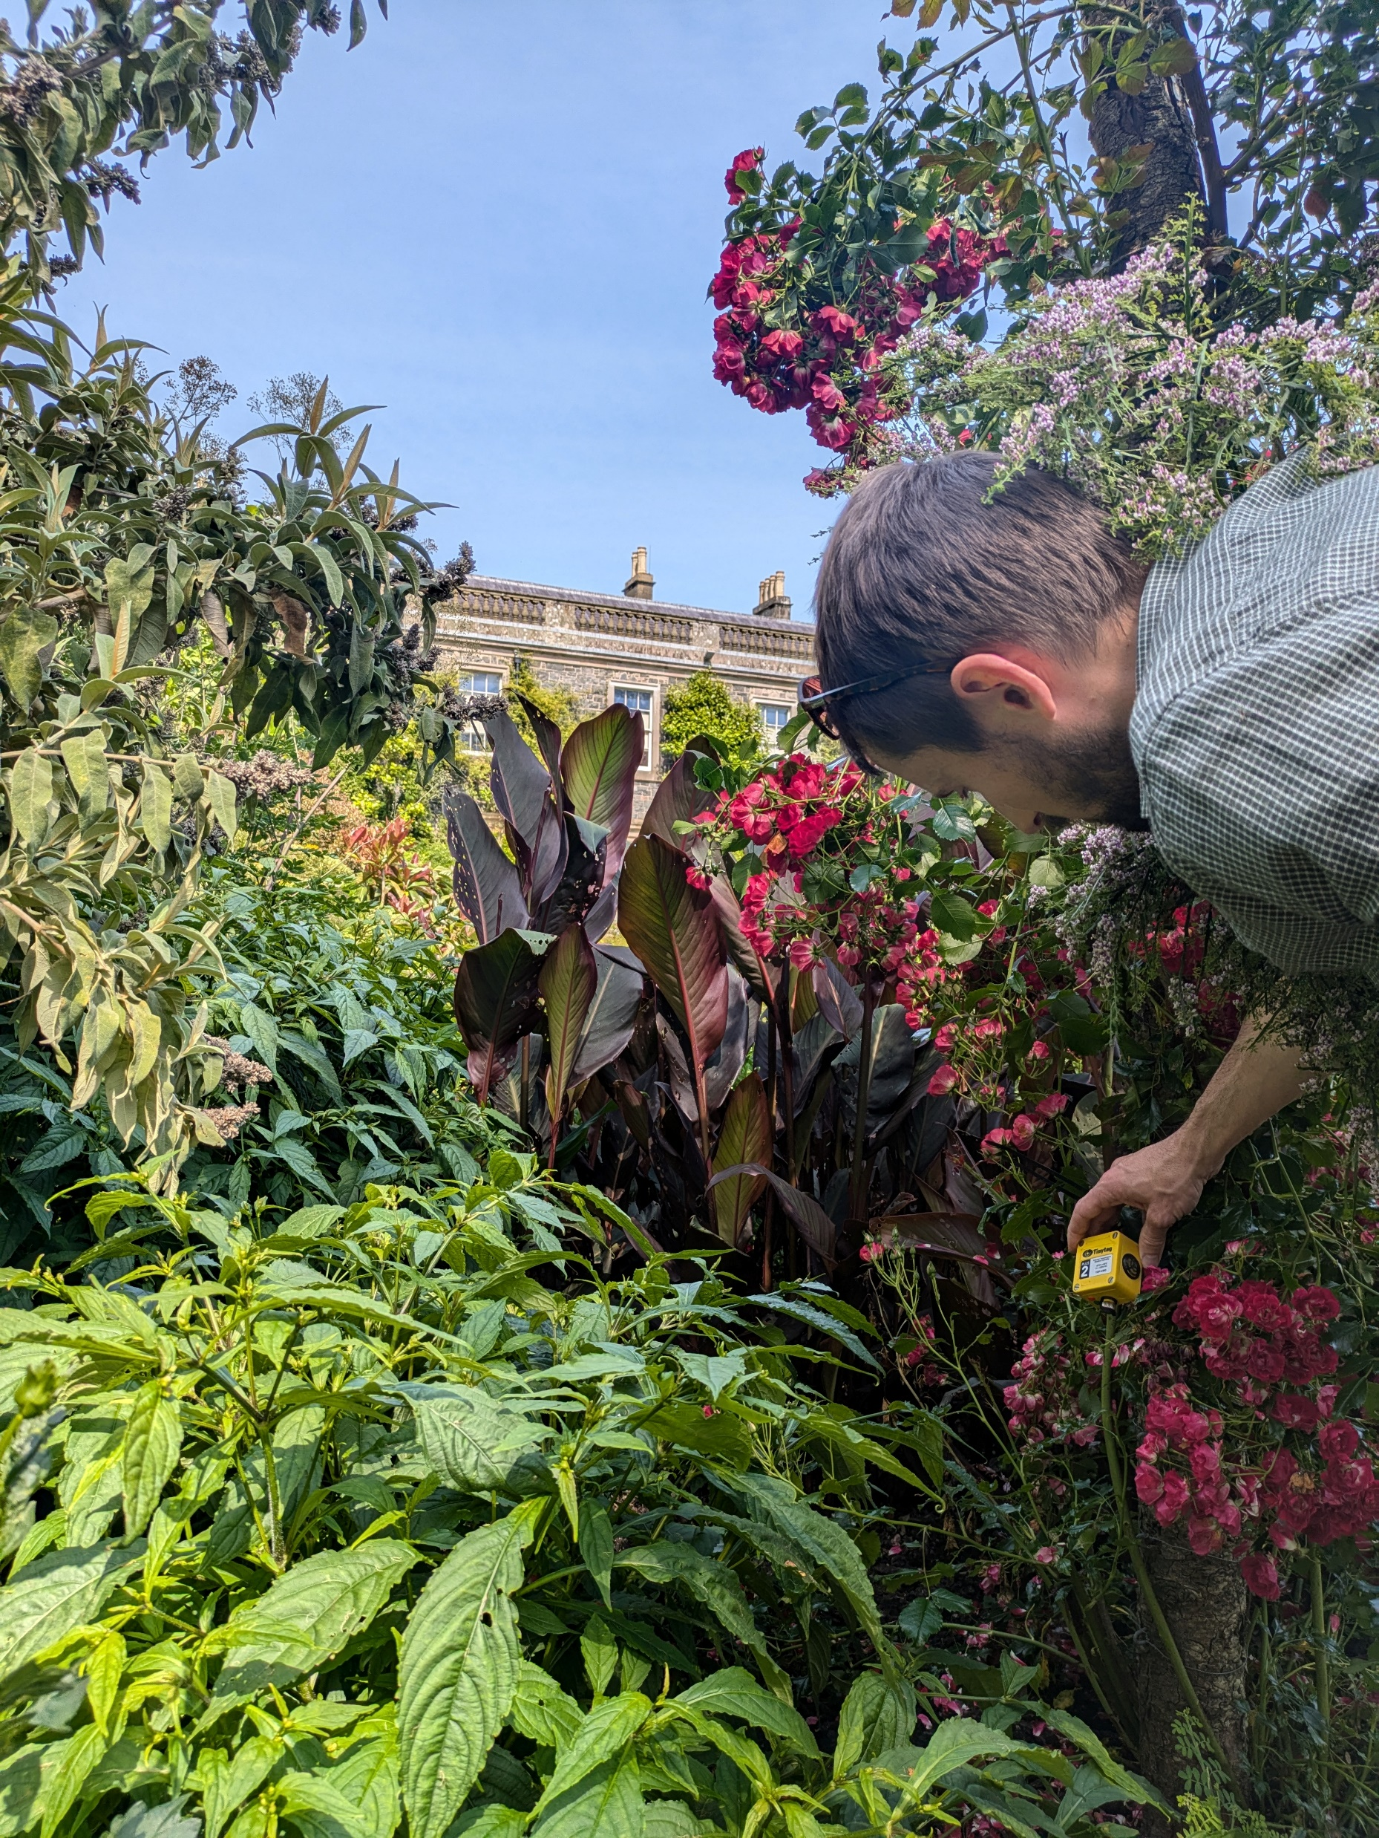
Mount Stewart
Measure the differences in conditions at each Microclimates
Compare data with Gardener experience
Find a new location for the ornamental garden
Spatial Differences

Slide 6
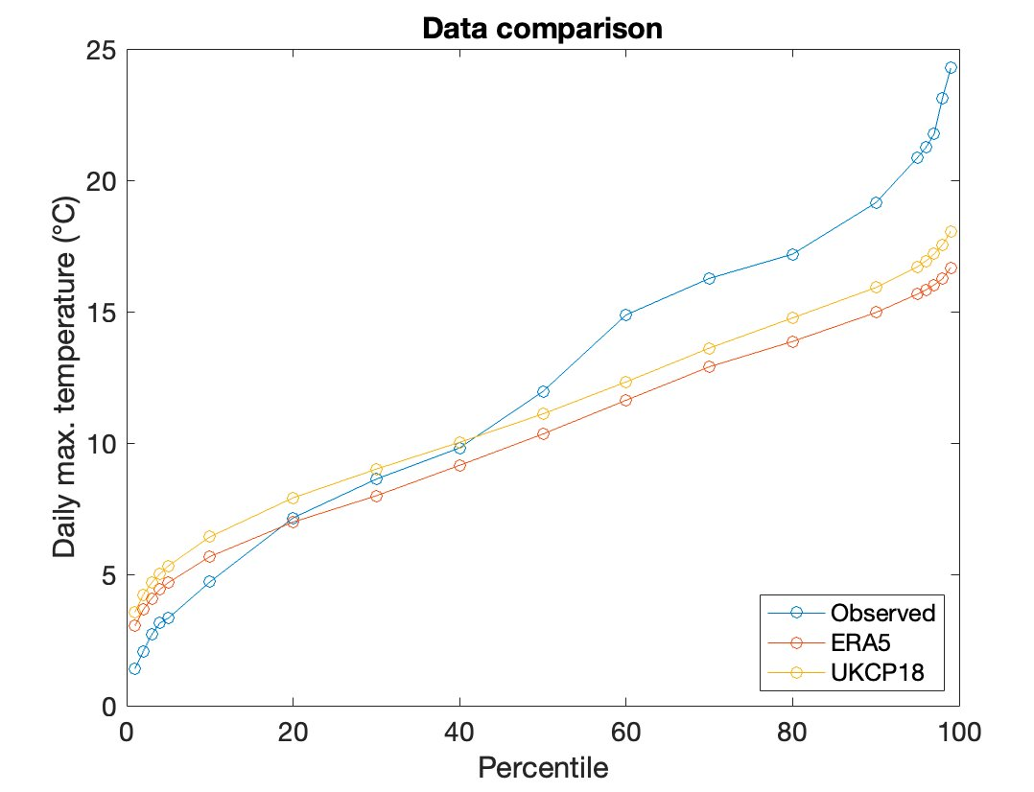
Mount Stewart

Slide 7
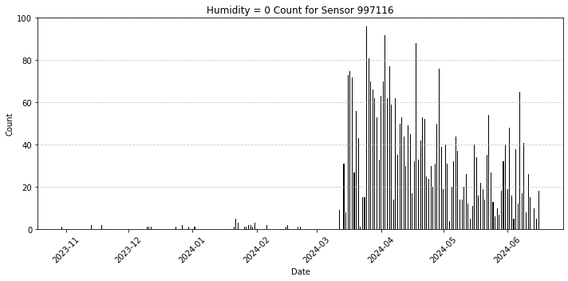
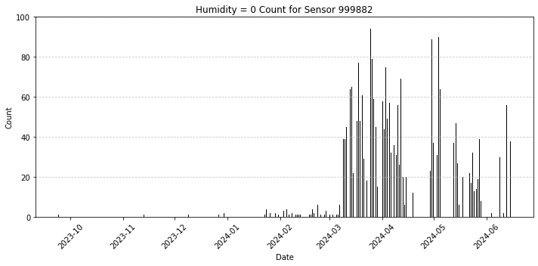
Mount Stewart

Slide 8
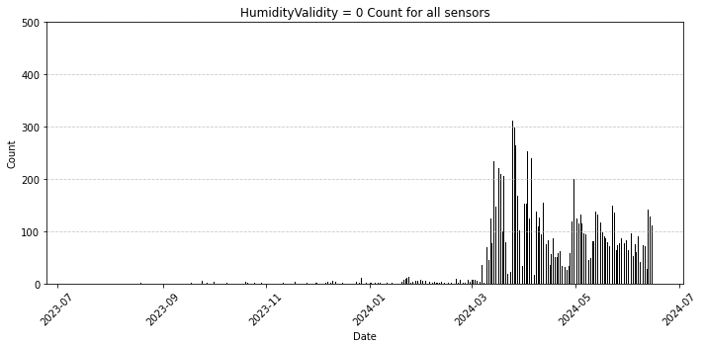
Mount Stewart

Slide 9

Mount Stewart
Measure the differences in conditions at each Microclimates
Compare data with Gardener experience
Find a new location for the ornamental garden
Spatial Differences

Slide 10
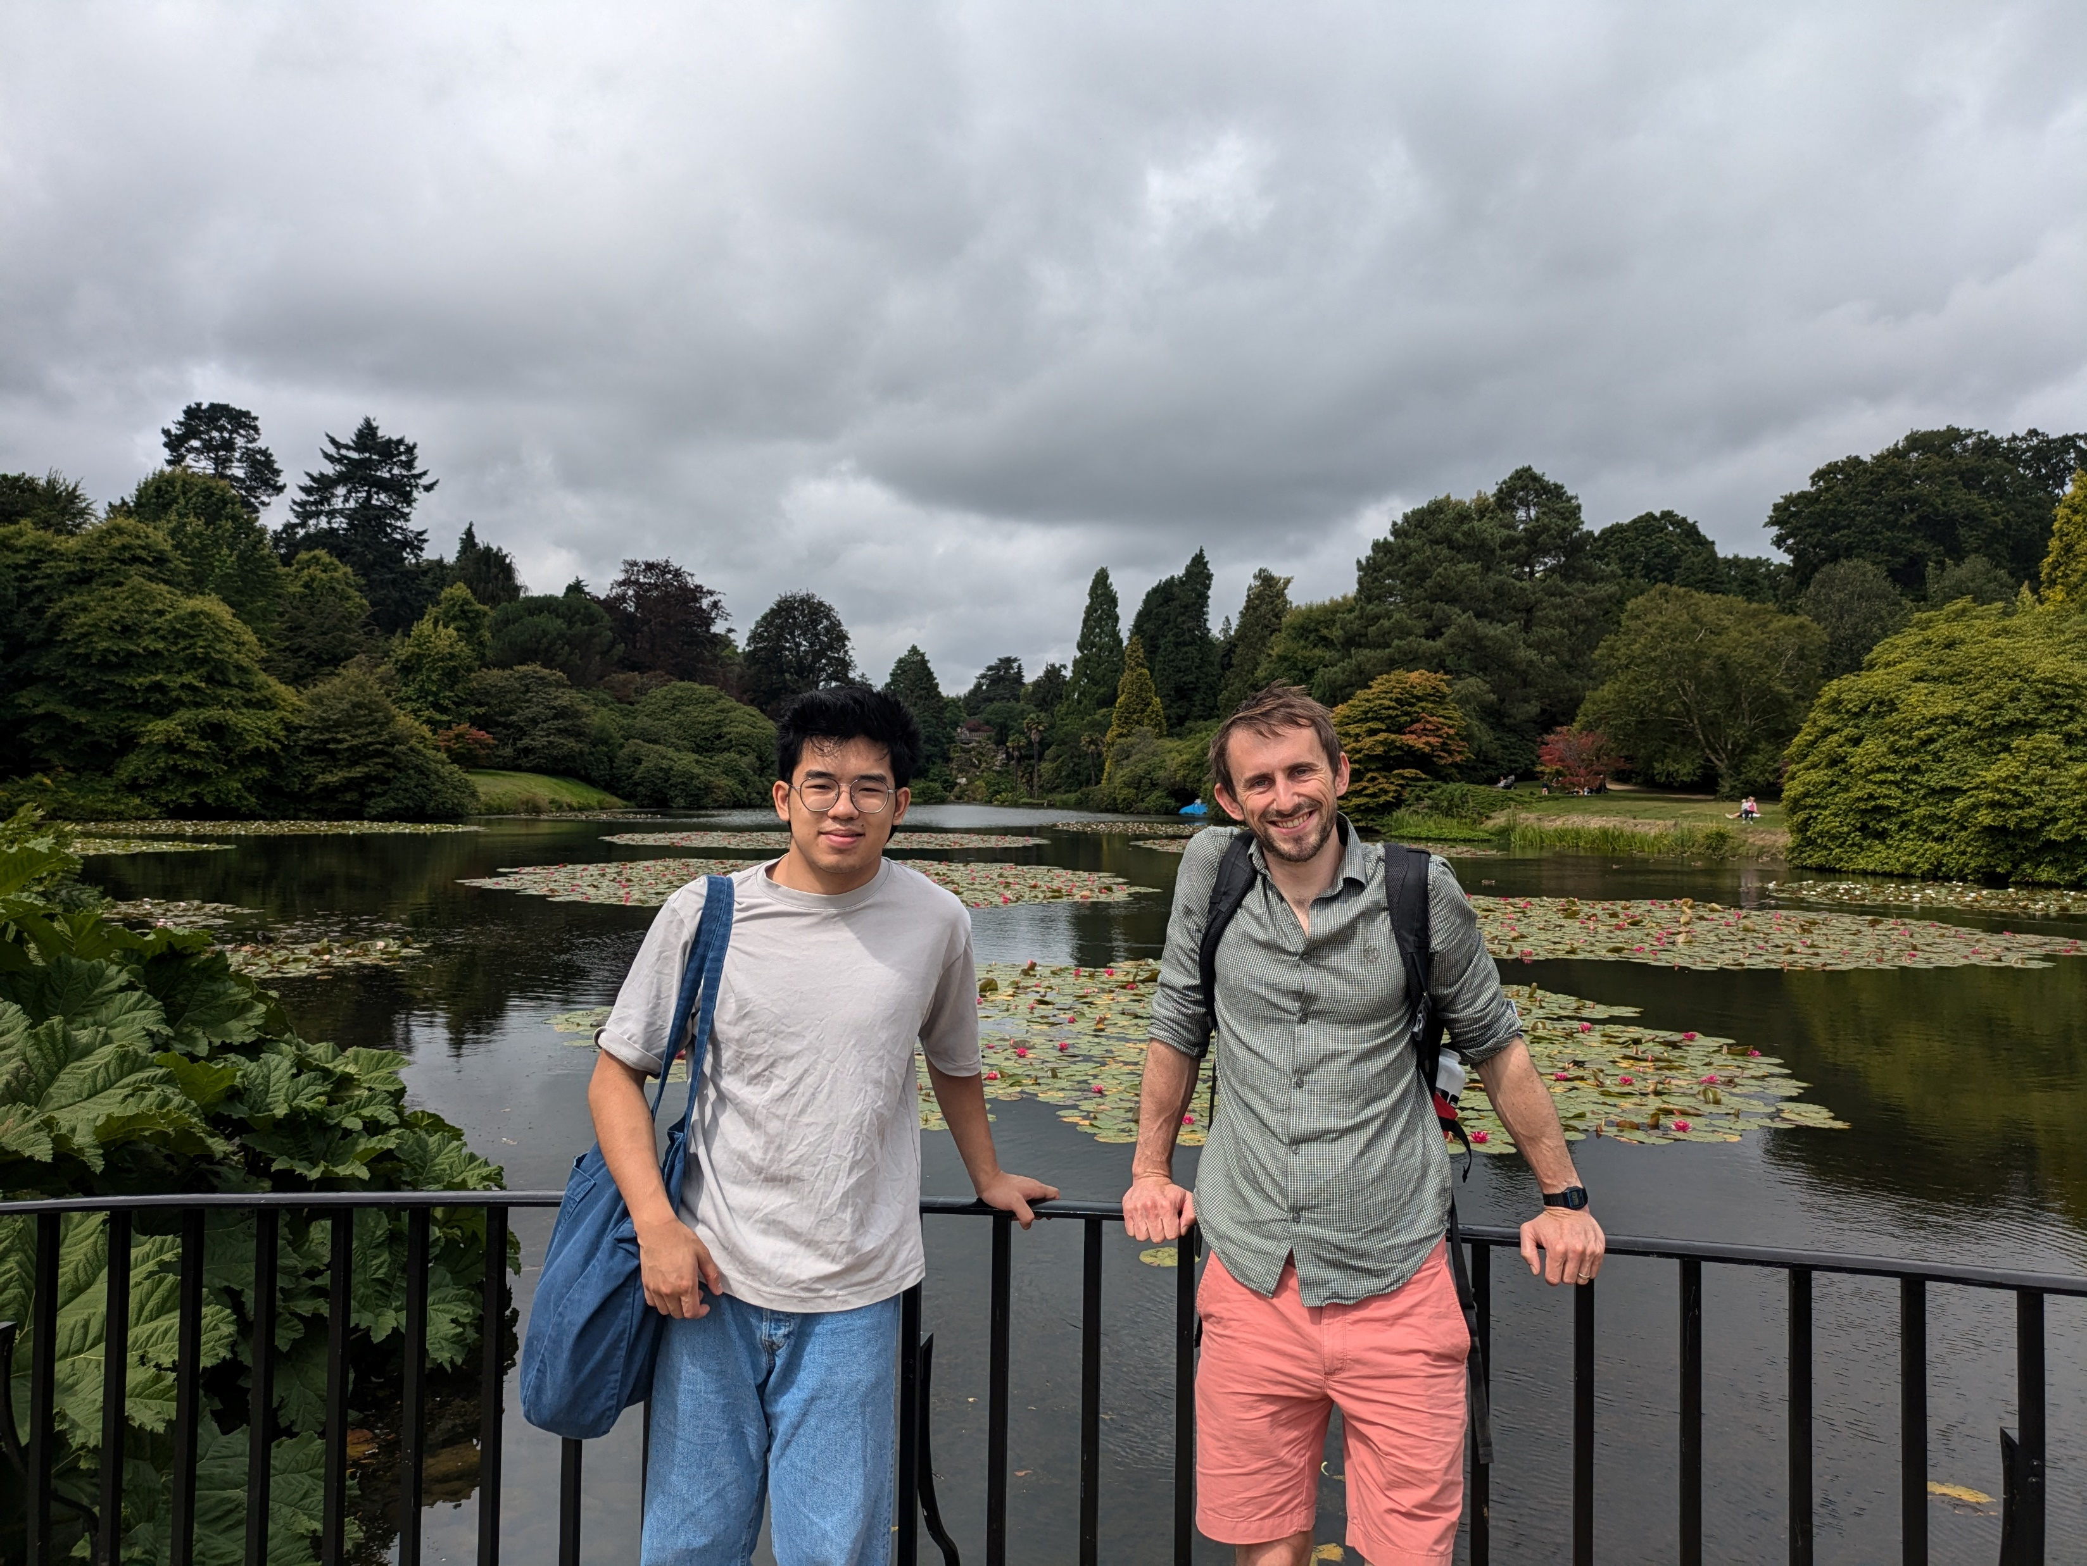
Sheffield Park
Use data to inform long term decision making
Inform decision making on planting trees
Long term data trends

Slide 11
Sheffield Park
In our team, there is such a willingness to learn, there is such a willingness to develop, and if the National Trust mirrors that and that gets replicated on other sites then that’s only a good, positive thing. The thing that we’ve lacked, which we are now getting, is data. That’s what we’ve really, really needed, because there’s been a lot of decisions in this landscape where it has been somebody looking at a space and going, ‘Oh that, yeah that will do, that will do well there’ and you are purely relying on that person to have a knowledge of everything: Sheffield Park, the specimen, the surroundings. We can’t just make decisions based off that. They probably could 70, 80 years ago, but not 15, 20 years ago.”
“The benefit that not just me, but I know the team have from having the plant database at your fingertips – the ability to learn about the site – it’s quicker, it’s more informed, they take more ownership over it, over their own learning because of it. So, can you imagine what it would be like if that data was in all of these other spheres? Whether that’s microclimates or general climate or rainfall. To be able to have that, without having to be here for years and years, to have that data when you start, you’d get to know the site a lot quicker.

Slide 12
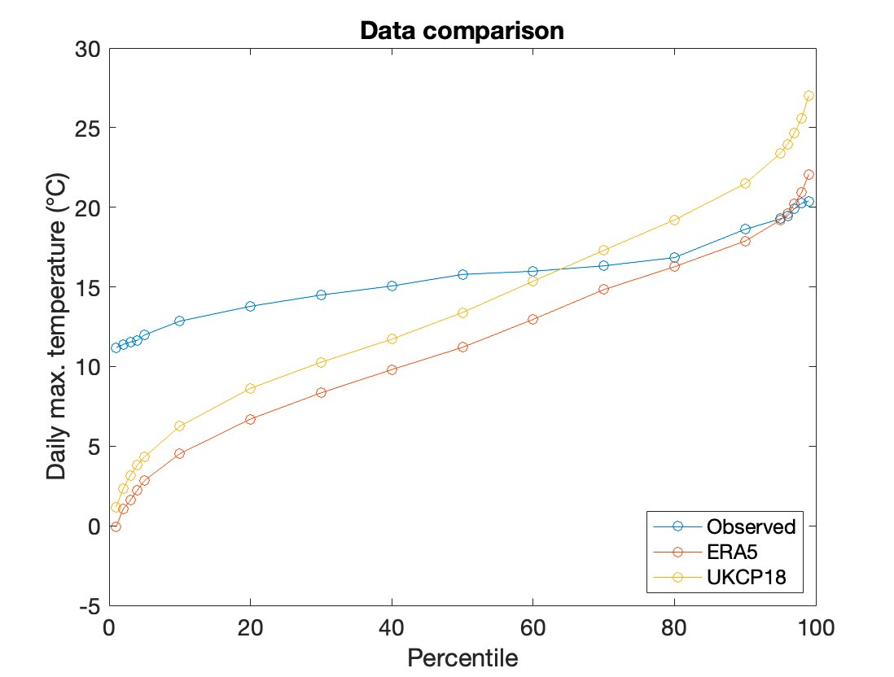
Sheffield Park
(Only 6 months of Data)

